Slide 1
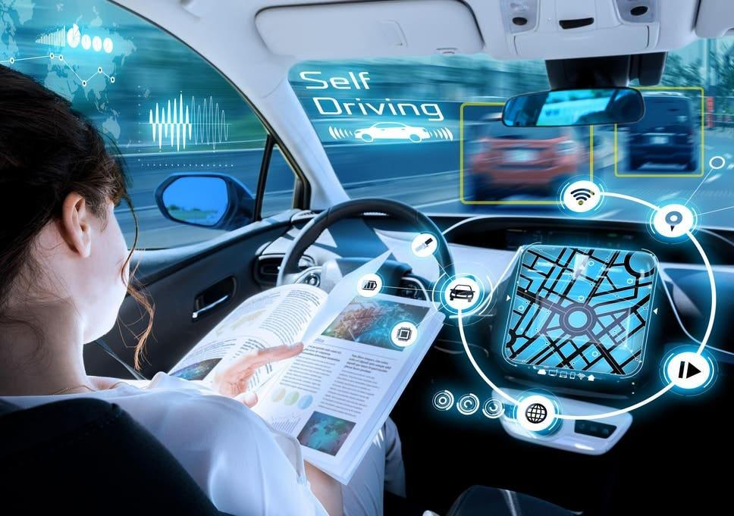

AI IN TRANSPORTATION PLANNING
ITE@UIUC DATA SCIENCE TEAM
Notes:
Welcome to the Transportation Data Science Team! Today, we are here to talk about the importance of AI in Transportation Planning!

Slide 2
WHAT IS ARTIFICIAL INTELLIGENCE?
Notes:
Imagine you have a really smart friend. Let's call him Alpha. Alpha is special because he can learn and get smarter just like you. When you first meet Alpha, he might not know much. But the more you talk to him, the more he learns from you.
Think about when you play a new game. At first, you might not know the rules, but as you play more, you get better at it. Alpha learns in a similar way. If you show Alpha lots of pictures of cats and tell him these are cats, soon he'll be able to recognize other cats by himself, even ones he's never seen before!
But Alpha doesn't just learn about cats. He can learn about anything! You can teach him to recognize songs, help with math problems, or even tell jokes. The more Alpha learns, the better he can help you.
Alpha is like a computer brain that can be put into many things, not just a robot body. This computer brain is what grown-ups call "Artificial Intelligence," or AI for short. It's like a super-smart helper inside computers and gadgets.
You know how you use your voice to ask a smart speaker to play your favorite songs? That speaker has AI inside it, just like Alpha. It listens to your voice, understands what you want, and plays the song for you. Or when you play a video game, and the game gets harder as you get better? That's AI learning from how you play and trying to make it more fun for you.
But don't worry, even though AI is super smart, it's not like a human brain. It doesn't have feelings or thoughts like we do. It's a tool that people like scientists and engineers make to help us do things faster and easier. And just like your toys, someone is always there to make sure AI is safe and working right.
So, next time you see a robot in a movie or use a gadget at home, remember that it might have AI like your friend Alpha, learning and helping in its own special way!

Slide 3
OK, BUT WHY TRANSPORTATION PLANNING?
Notes:
"Imagine you live in a big puzzle where each piece is a place like your home, school, the grocery store, or the park. Transportation planning is like figuring out the best way to connect all these pieces so everyone can move around easily and safely.
Helps Us Get Around: First, transportation planning makes sure that we can travel from one place to another smoothly. Whether we're walking, biking, taking a bus, or driving in a car, we need good roads, paths, and bus routes. It's like making sure there are enough bridges and paths in a game so that all the players can move around without getting stuck.
Keeps Us Safe: It's also about safety. Good transportation planning means fewer accidents. It's like setting rules in a game to make sure everyone plays safely without getting hurt.
Saves Time: Nobody likes to be stuck in traffic, right? Transportation planning helps reduce traffic jams, so your parents can spend less time driving and more time doing fun things with you!
Good for the Environment: When we plan transportation well, we can also take care of our planet. It means less pollution from cars because we can use more buses, trains, or bikes. It's like choosing to clean up the playground so it's a nicer place for everyone.
Helps Our Economy: And guess what? It also helps our towns and cities grow stronger. When it's easy for people to move around, they can go to different jobs, shops can get the supplies they need, and businesses can serve more people.
So, transportation planning is not just about roads and buses. It's about making our lives better every day, taking care of our planet, and making our towns and cities great places to live!

Slide 4
HOW CAN WE COMBINE AI & TRANSIT PLANNING?
Notes:
"AI is like a super-smart friend who plans our travel routes, manages traffic lights, and keeps an eye on road safety. It helps buses and trains run on time, makes our roads safer, and even helps our environment by reducing pollution from cars. Imagine a world where traffic jams are rare and every journey is smooth and quick – that's what AI is working towards!"
"So, next time you're in a car, on a bus, or walking through the city, think about the invisible helper, AI, making sure you get to where you're going safely and quickly. Isn't it amazing how technology can make our lives better? What do you all think about that? Let's talk!"

Slide 5
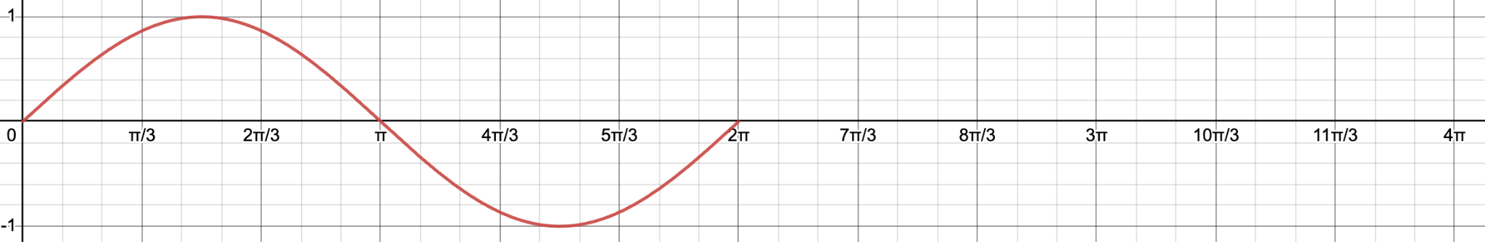
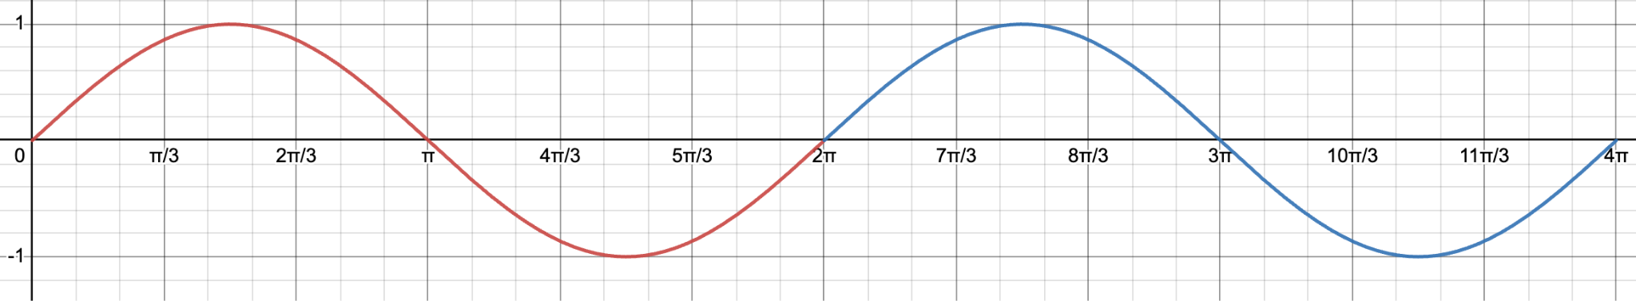
HOW DOES AI PREDICT FUTURE TRENDS?
Can you predict this trend?
Notes:
The first question we ask ourselves is “How does AI predict future trends”? Now I’m gonna ask for you to just shout out where exactly do you think this goes? Can you predict this trend? First we go up, then down, and then where? It’s pretty easy. *pause* The pattern will continue as shown because that’s what we know about the sign wave’s nature, but also because you can just look at it and intuitively tell that it just goes like so. Alright are you ready for the next trend to predict.

Slide 6
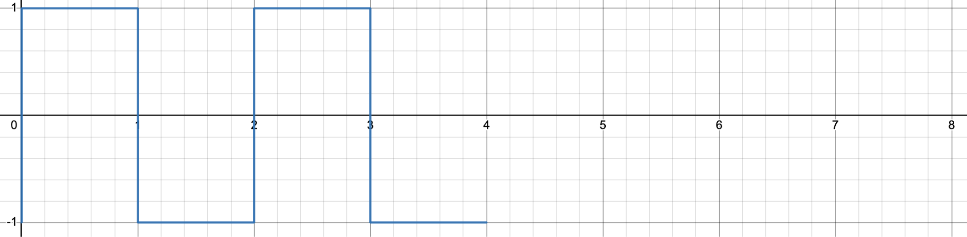
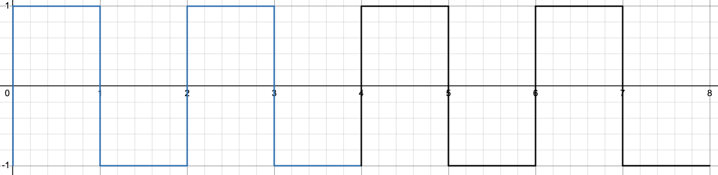
How about this one?
Notes:
How do you think this trend will go? It looks like we go up and then down and then up and so on so forth. *ask for engagement*. Yep, so we’re gonna be going up and down still. You’re almost thinking like and AI, isn’t that crazy? Alright one more are you ready? This one is a little harder.

Slide 7
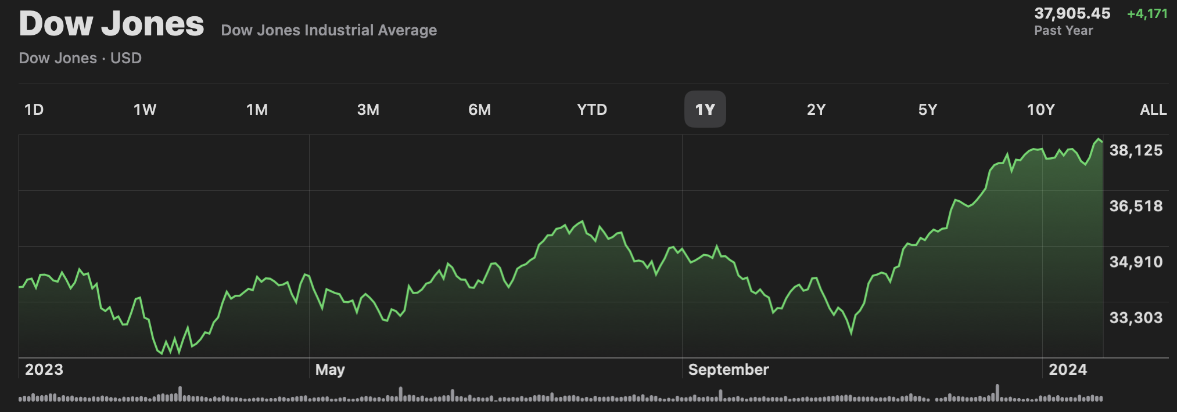
So…How about this one?
Notes:
So we have the Dow Jones Industrial Average for the past year. The Dow Jones industrial average consists of 30 of the biggest companies in the US and the graph is a representation of how they perform as a whole. Do you think you can predict this trend?

Slide 8

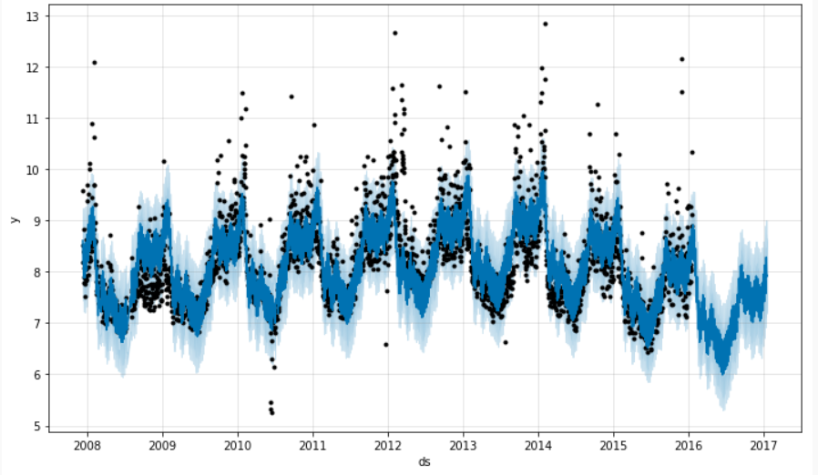
SO…HOW DOES AI PREDICT FUTURE TRENDS?
Notes:
The program we used to do this forecasting data is a program created by facebook/meta called Prohpet (specifically called FBProphet)

Slide 9
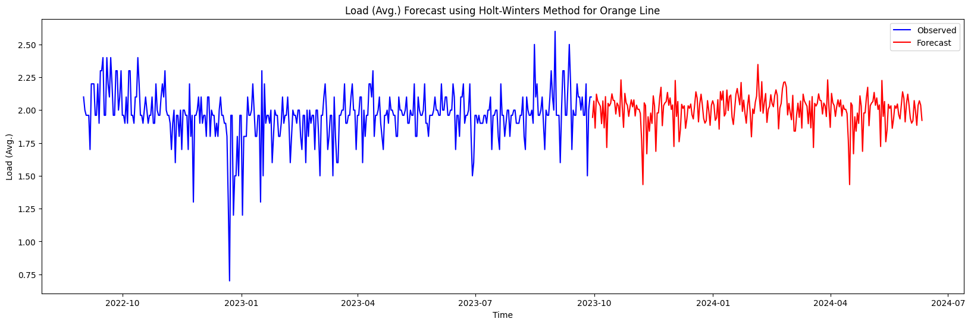
DATA VISUALIZATIONS - Orange Line
Above: Full Forecast
Left: Forecast Faded

Slide 10
DATA VISUALIZATIONS - Silver Line

Slide 11
DATA VISUALIZATIONS - Green Line

Slide 12
CONTRIBUTORS
Louis Sungwoo Cho, Civil Engineering (Transportation) Major, Computer Science Minor
Mitchell Eng, Civil Engineering (Transportation) Major
Jae Min Sim, Civil Engineering (Transportation) Major, Computer Science Minor
Kosuke Ito, Aerospace Engineering Major, Computer Science Minor
Jisu Hong, Civil Engineering Major
Brandon Lee, Systems Engineering & Design Major

Slide 13

REFERENCES
Code reference: https://github.com/lotlouischoitslab/ITE_UIUC_EOH_2024

Slide 14


